Slide 1

Techpoint LSAR Review Tool

Slide 2
Company Overview
Techpoint Services Ltd was formed in 2021.
Techpoint Services is a micro SME and has a team of LSA engineers, technical authors and illustrators.
Techpoint Services specializes in Integrated Logistics Support (ILS) - Technical Publications and Logistic Support Analysis (LSA).
Office located in Ammanford, Wales.
© Techpoint Services Ltd (2026)

Slide 3
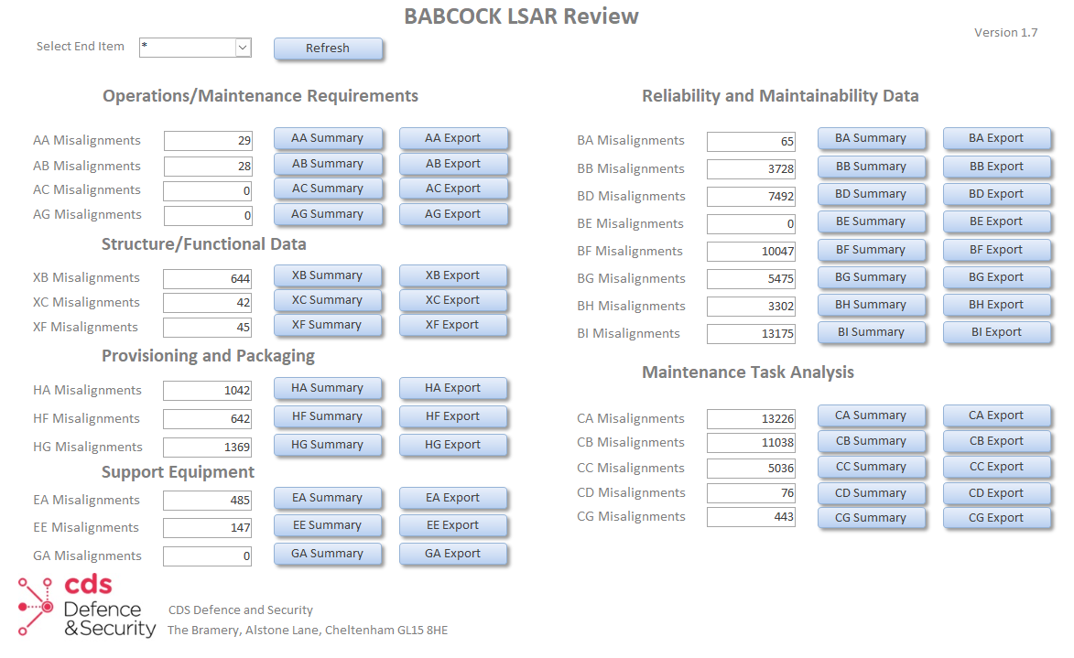
Techpoint LSAR Review Tool
At Techpoint Services we have designed the LSAR Review Tool for:
NH 90 - Airbus Helicopters
Boxer - Artec GmbH
General Dynamics
CDS Defence & Security
© Techpoint Services Ltd (2026)

Slide 4
Standards and file formats
The Techpoint LSAR Review Tool works for the following standards:
MIL-STD-1388-2B, Def Stan 00-60 (00-600), GEIA-STD-0007
The Techpoint LSAR Review Tool works with:
OCDB connections to the LSAR
Microsoft Access and Microsoft Excel outputs
Full files – .dat, .txt and .xml
© Techpoint Services Ltd (2026)

Slide 5
Overview
Summary buttons
Export buttons
© Techpoint Services Ltd (2026)

Slide 6

Summary buttons
When a summary button is clicked on it will give an overview of the errors.
You can then interrogate the database to find out further information on the error.
© Techpoint Services Ltd (2026)

Slide 7
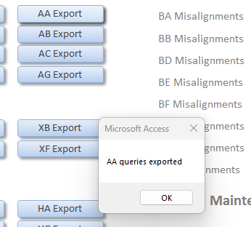
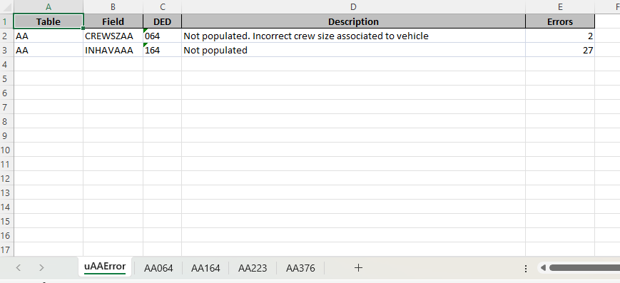
Export buttons
When an export button is clicked on, it will export the errors for that table into Excel format.
© Techpoint Services Ltd (2026)

Slide 8
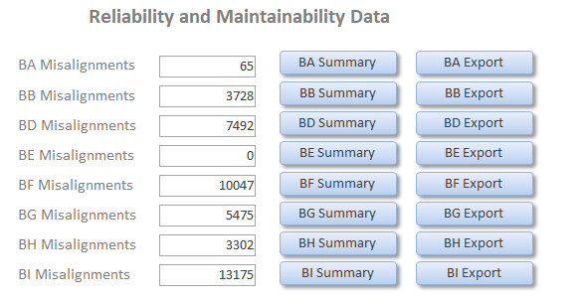
Reliability and Maintainability Data
The Techpoint LSAR Review Tool currently review the BA, BB, BD, BE, BF, BG, BH and BI tables.
Currently checks 36 DEDs for errors
Can be adjusted to match user guide
© Techpoint Services Ltd (2026)

Slide 9
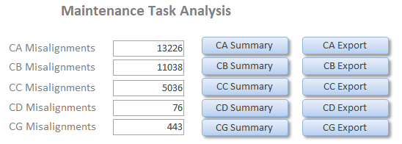
Maintenance Task Analysis
The Techpoint LSAR Review Tool currently review the CA, CB, CC, CD and CG tables.
Currently checks 23 DEDs for errors
Can be adjusted to match user guide
© Techpoint Services Ltd (2026)

Slide 10
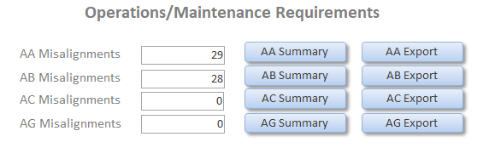
Operations/Maintenance Requirements
The Techpoint LSAR Review Tool currently review the AA, AB, AC and AG tables.
Currently checks 13 DEDs for errors
Can be adjusted to match user guide
© Techpoint Services Ltd (2026)

Slide 11
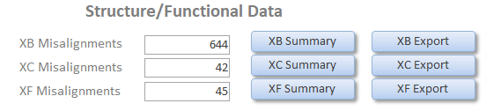
Structure/Functional Data
The Techpoint LSAR Review Tool currently review the XB, XC and XF tables.
Currently checks 7 DEDs for errors
Can be adjusted to match user guide
© Techpoint Services Ltd (2026)

Slide 12
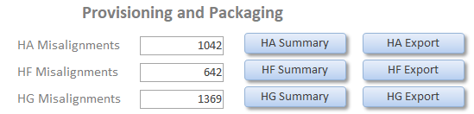
Provisioning and Packaging
The Techpoint LSAR Review Tool currently review the HA, HF, HG and HO tables.
Currently checks 25 DEDs for errors
Can be adjusted to match user guide
© Techpoint Services Ltd (2026)

Slide 13
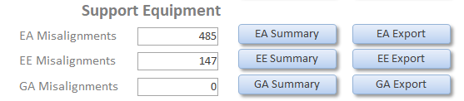
Support Equipment
The Techpoint LSAR Review Tool currently review the EA, EE and GA tables.
Currently checks 18 DEDs for errors
Can be adjusted to match user guide
© Techpoint Services Ltd (2026)

Slide 14
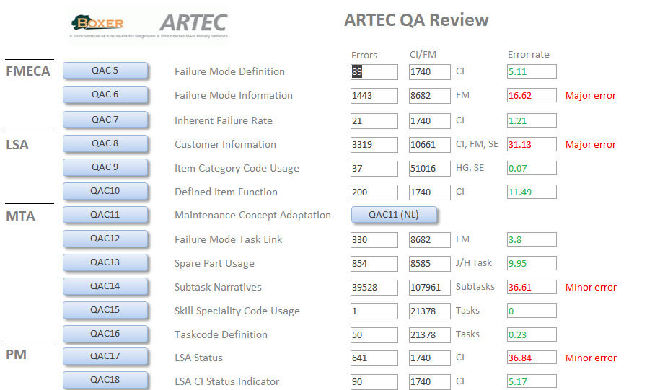
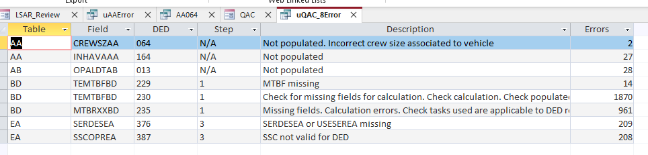
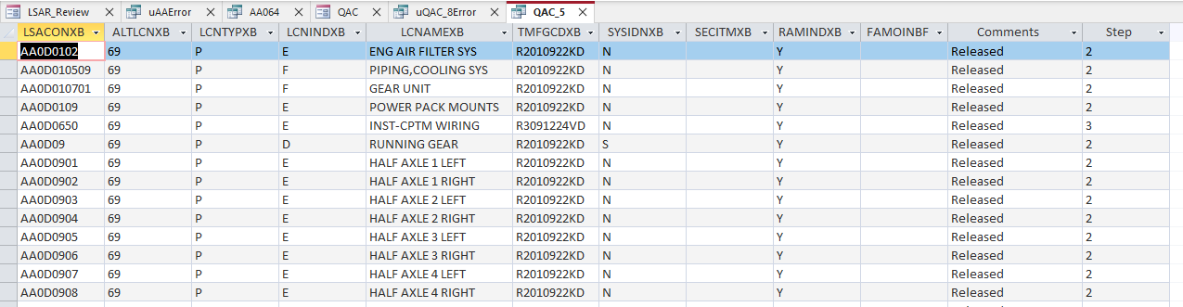
Quality checks for deliveries
Some customer had specific quality gates that the LSAR had to achieve. These can also be built into the Techpoint LSAR Review Tool:
© Techpoint Services Ltd (2026)

Slide 15

Techpoint Services Ltd /techpointservices.co.uk
Adam Poole
Managing Director
+44(0)7398 424001
adampoole@techpointservices.co.uk
33C Quay Street, Ammanford,
Carmarthenshire, SA18 3BS Wales
© Techpoint Services Ltd (2026)

